Slide 1

In nutshell & Angular Module

Slide 2


Devonfw
Use standards to heal the “Not invented here syndrome”* that is very common among architects and engineers
Capgemini has strong JEE architects, but often they start re-inventing the wheel on
Technical Architecture
Technology Stack
Code Style
Software Engineering Process
Building Blocks
Integration of technical components
Stop creating new wheels for logger, service-framework, historization, etc.
Across countries
* https://en.wikipedia.org/wiki/Not_invented_here

Slide 3

Devonfw
What if Capgemini SBU had a widely accepted software platform for Custom Solution Development?

Slide 4
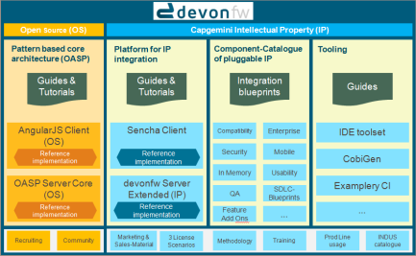
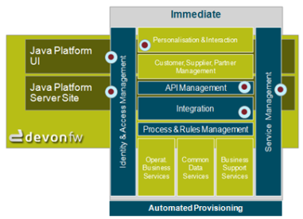
Devonfw in a Nutshell
A platform to …
speedup CSD projects
reduce risk of CSD projects
support bids with solutioning
guide internal communities
active knowledge management
support recruiting
attach digital innovation
align staff
ability to staff cross-country
Industrialize no-shore
make a home for engineers
Devon is the Capgemini APPS2 standard platform (IP) with an JEE open source architectural core (OASP).

Slide 5
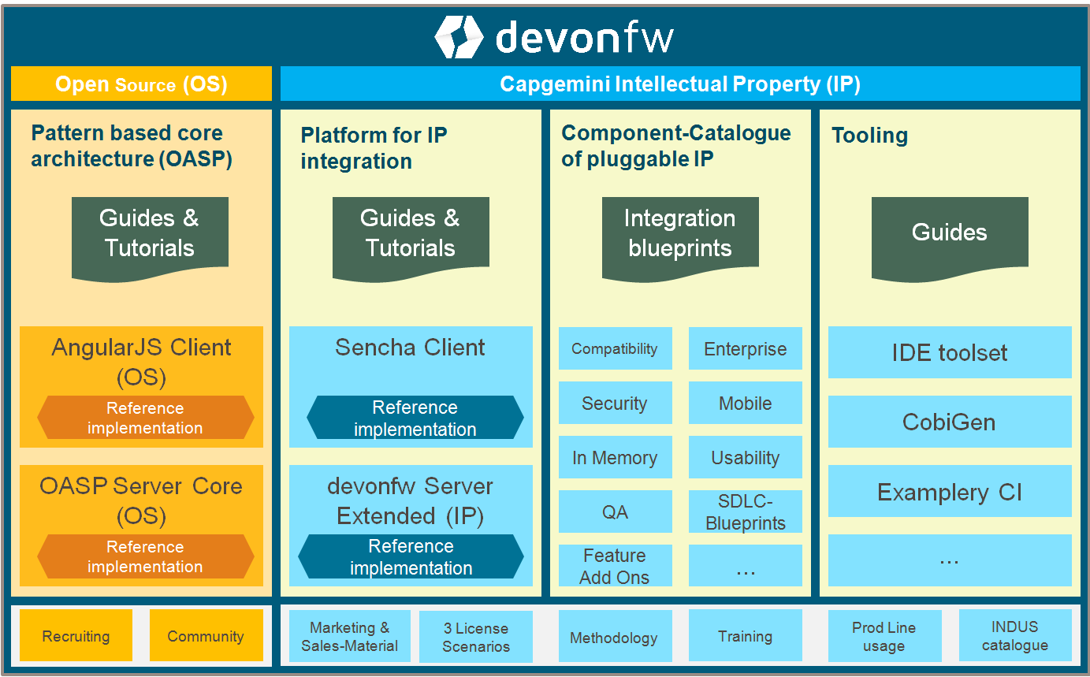
Devonfw building blocks: OS & IP

Slide 6










Devonfw base technologies
SERVER
CLIENT

Slide 7







Devonfw main features
Download & start developing: no extra installation, no extra configuration. All the software and tools are included, configured and installed out of the box.
1
Local Machine

Slide 8
Devonfw main features
Download & start developing: no extra installation, no extra configuration. All the software and tools are included, configured and installed out of the box.
1
2
Preconfigured and feature rich IDE ready to start developing apps
Local Machine
Templates and Archetypes to generate new pre-structured projects
Cobigen: generate code
Devcon: manage your project
IP Modules: reusable features

Slide 9

Devonfw Eclipse & server app structure
+
+
Preconfigured IDE
Multiple instances / customized for projects
App structure (spring + oasp4j archetype)
Stand-alone Spring apps out of the box
Embedded Tomcat
Flyway integration (db integration ootb)
Basic authentication (login) and authorization (role based) implementation
Integration of IP Modules
Reporting - Winauth(AD & SSO)
Async Module - I18N
Spring Data integration - etc.
Plugins:
Checkstyle (keep Java coding standards)
FindBugs (identify potential software bugs)
SonarLint / Sonarqube (on-the-fly feedback on new bugs and quality issues)
Cobigen (code generator)

Slide 10
Devonfw client apps
Templates to start new apps with a base structure ready
Sample apps to show developers how to start client implementation
Apart from the official documentation, Devon provides a well detailed guide for developers
… or use other client frameworks or technologies
Notes:
DEMO: (Run oasp4j sample app) Run the previously created Sencha app and connect it with the server. The app is empty but ready to start. Mention the Starter Template, show the documentation (devon4sencha part)

Slide 11
Devonfw Cobigen
Cobigen generates a fully functional structure of CRUD DAO & CRUD REST operations, including all the needed transfer objects.
Entity
SERVER
Cobigen is a plugin for Eclipse that is included in Devon in order to boost the creation of the recurrent parts of the web applications.
Eto
Cobigen generates all the needed elements to reflect the Eto in client side.
CLIENT

Slide 12

Devonfw Summary
QUALITY APPS & BOOST PRODUCTIVITY
Customized and feature rich IDE
Project Templates serv. & cli.
Code generator (Cobigen)
Projects manager (Devcon)
Pre developed modules (IP)
Detailed docs and examples

Slide 13


OASP4js Version 2
JavaScript Client
June 2017 Version 2
AngularJS
Angular
Git: https://github.com/oasp/oasp4js

Slide 14
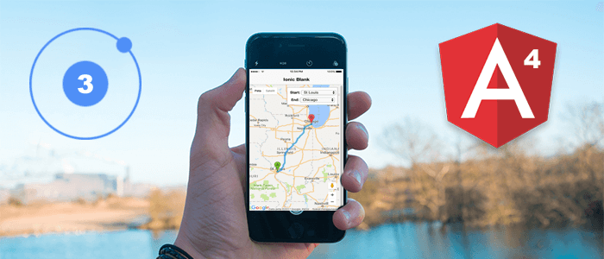

OASP4js Version 2
Based on Angular (version 4)
Integration of Covalent and Bootstrap offering a large number of components
Architecture Guide showing the design (decisions) of the framework
Different training options available
In active use in Germany, Spain and Italy
Integrated with the CobiGen code generator which can create complete CRUD-Dialogs (based on server side entities or CTOs) with features like pagination, sorting and filtering
Extended application template
Alternative Application available template for Ionic 3 (Hybrid mobile apps)
Alternative CobiGen Code generation for Ionic 3 applications
A stronger community with active participation from Germany, Poland and Spain

Slide 15
OASP4js Version 2
My-thai-star, a showcase and reference implementation in Angular of a real, responsive usable app using recommended architecture and patterns
Tutorial using my-thai-star as a starting point
Devon Methodology
https://github.com/devonfw/devon-methodology

Slide 16
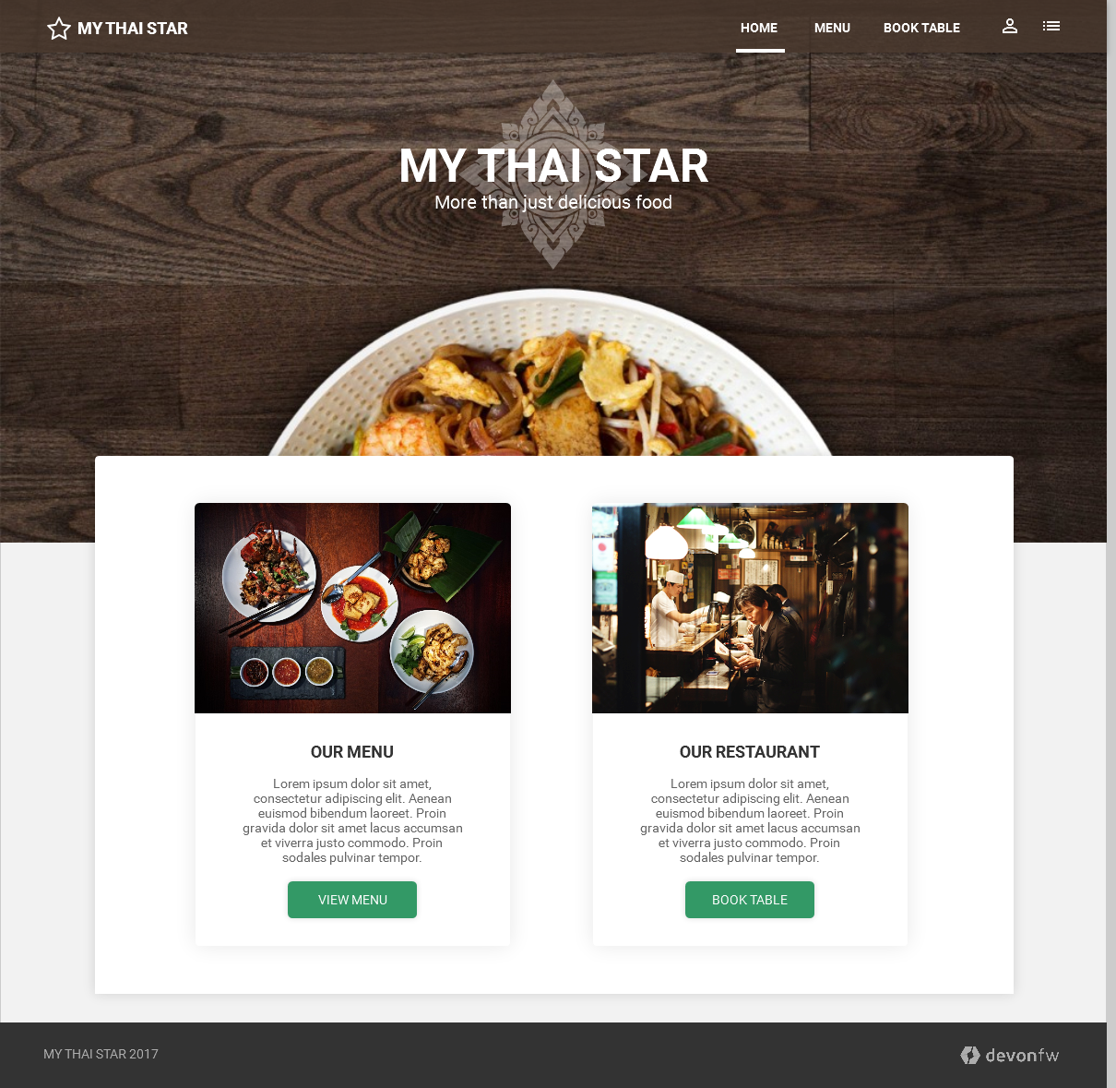
MyThaiStar – why do we need a new devonfw sample application?
Make it more attractive than the old example from an end user point of view – also usable for sales purposes
Add software development methodology (incl. early phases)
Current restaurant sample is „just“ code
Showcase Production Line usage
Also include the tool view to showcase the full delivery pipeline

Slide 17
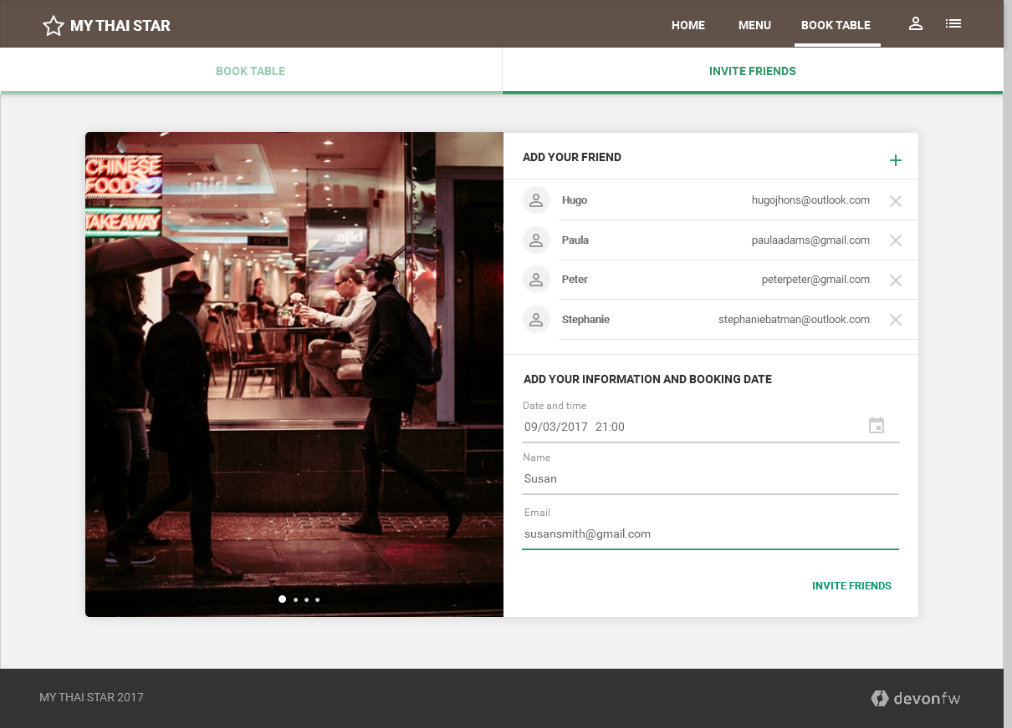
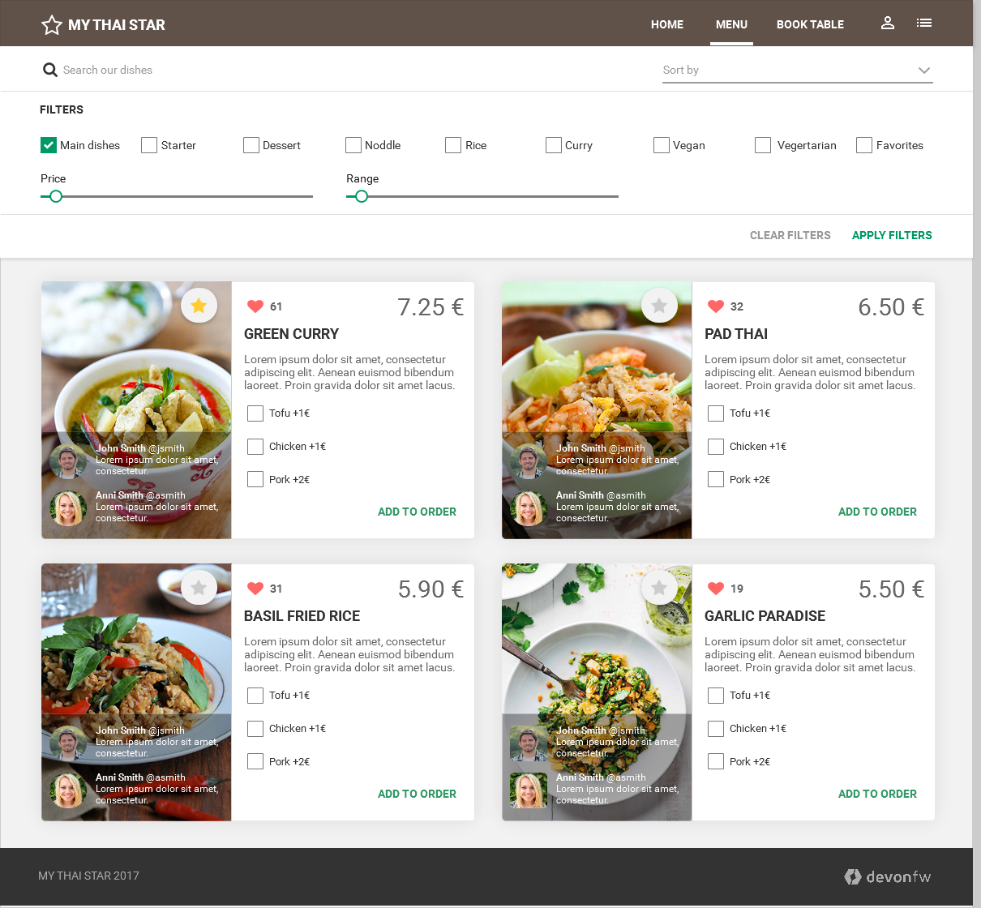
MyThaiStar – the new digital restaurant
MyThaiStar – the new devonfw example application – has been relaunched Q3 2016 as pure community activity. Contribution is open for everyone inside Capgemini.
The new example still sticks to the domain of restaurants but now the customer who visit the restaurant is the main actor.
All new features are easy to understand, follow the KISS-principle and are independent from any business domain (everyone understand it as everyone has visited a
restaurant before).
By diving into this example you’ll learn how to apply devon for your projects and you’ll gain knowledge about several best practices how to do it.

Slide 18
MyThaiStar Digital Feature – Browse the Digital Menu
Digital Menu
Order your dish before visiting the restaurant and reduce your waiting time.
Use a filter to find your favorite dish, decide which meat you like and order it easy before you visit.

Slide 19
MyThaiStar Digital Feature – Invite your Friends
Invite friends
You don’t know how many guests you expect? The use our new Invite your friend feature. Just enter your friends email address of potential guests.
Everyone receives an invite and according to their answer the system will book the table automatically – with the right number of guests!

Slide 20
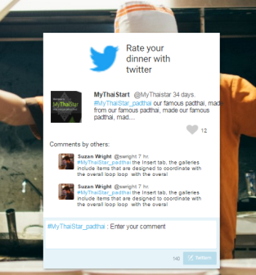
MyThaiStar Digital Feature - Rate your menu using Twitter
Rate menu by Twitter
Give us feedback after you have visited us. By integrating twitter in our rating system you only need a twitter account to give us feedback or to add you favorite dished to your favorite list.
Further you can read other comments from other guest to find some new, delicious food for your visit.

Slide 21



Technology
FRONTEND
Angular 4 or greater
TypeScript
Angular CLI
Webpack included.
Karma testing framework.
Material design
Angular components
https://material.angular.io/
Covalent framework https://teradata.github.io/covalent/#/
SASS
Integrated with Angular CLI in application configuration by default.
IDE
VS Code
BACKEND
App structure (spring + oasp4j archetype)
Stand-alone Spring apps out of the box
Embedded Tomcat
Flyway integration (db integration ootb)
Basic authentication (login) and authorization (role based) implementation
Integration of IP Modules
Reporting - Winauth(AD & SSO)
Async Module - I18N
Spring Data integration - etc.

Slide 22
CobiGen
Live Demo

Slide 23
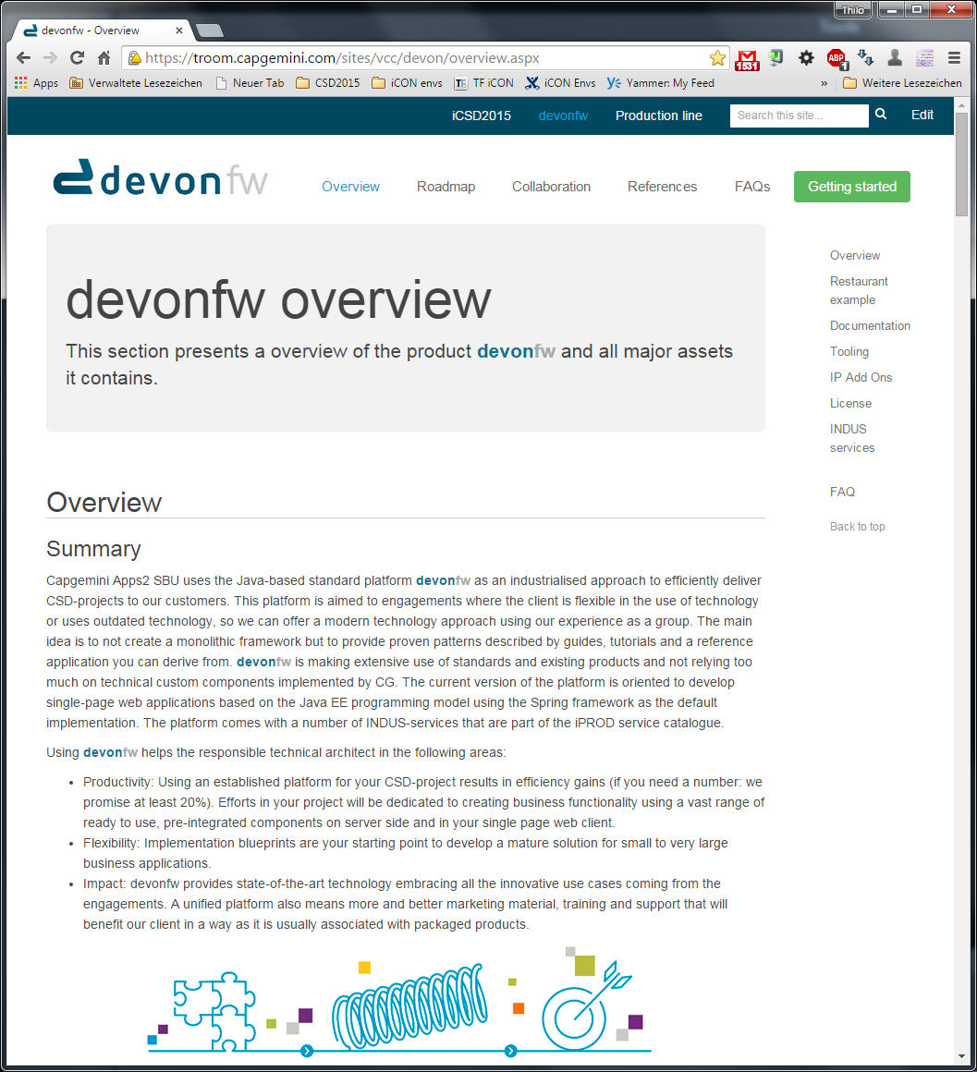
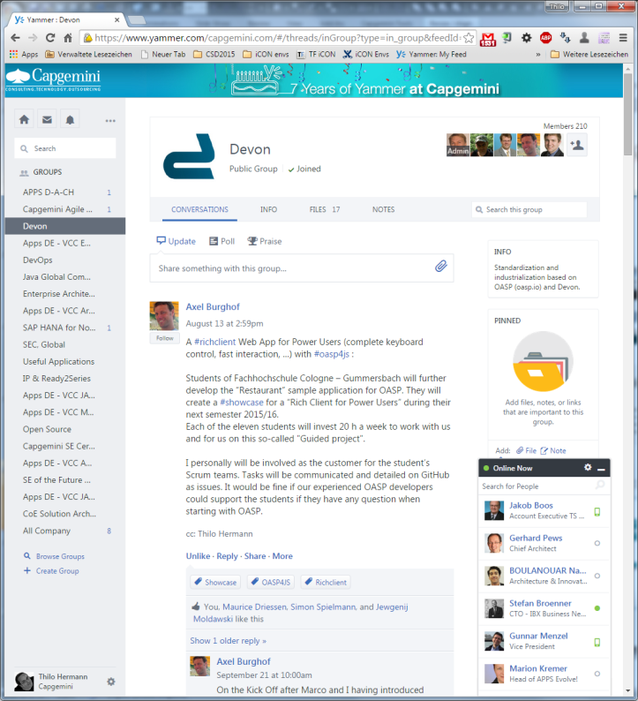
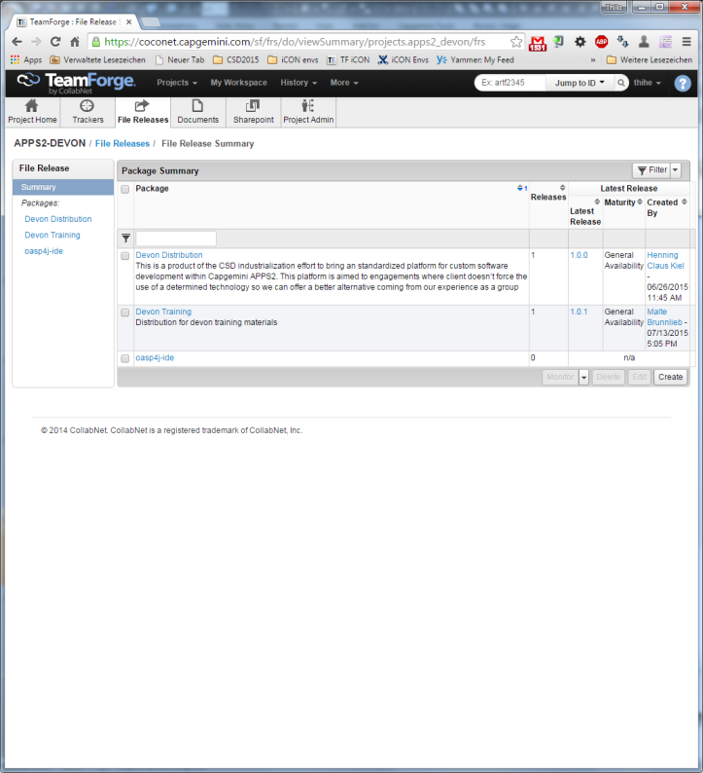
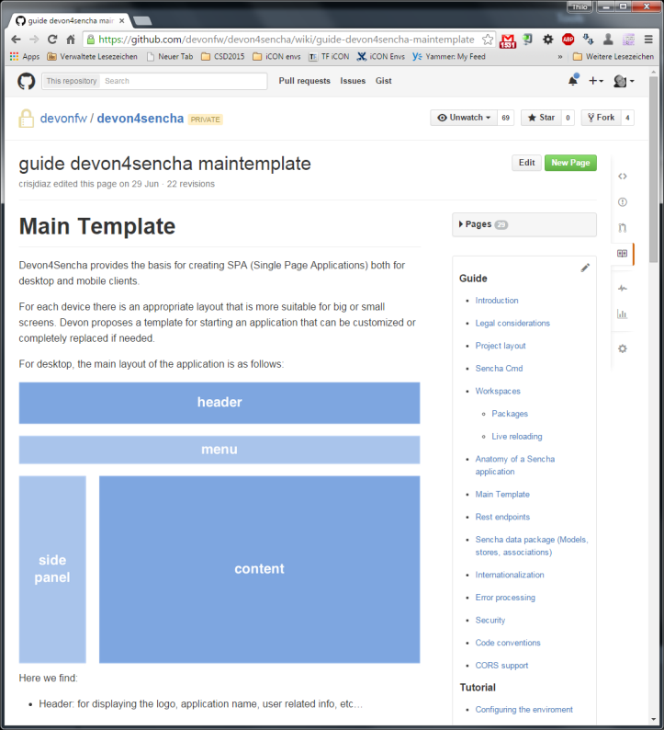
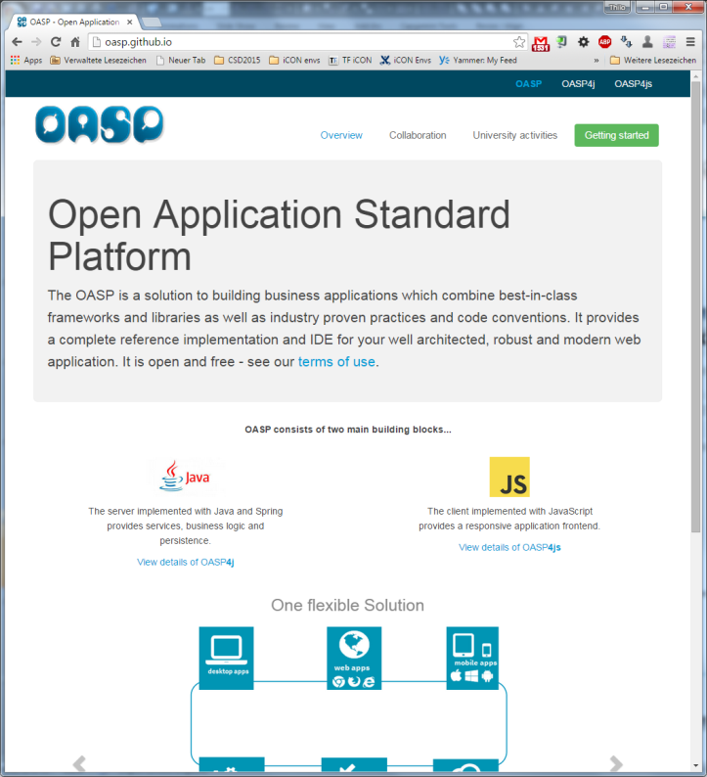




How to get in touch?
iCSD initiative is at your hand: Walkthrough – Sharepoint, Teamforge, GitHub, Yammer, Restaurant app ...
Sharepoint: https://troom.capgemini.com/sites/vcc/devon/overview.aspx
Teamforge: https://coconet.capgemini.com/sf/projects/apps2_devon/
Devonfw OS (OASP) GitHub: https://github.com/oasp/
Devonfw IP GitHub: https://github.com/devonfw
Yammer: https://www.yammer.com/capgemini.com/groups/devonfw

